Slide 1

Big Project – Final Presentation
By: Derek Chibbaro and Maggie Byers

Slide 2

Research Question & Background Information
Varsity Men's Basketball began in 1919
Conference Championships 2013 and 2015
Advanced to the Elite Eight in 2014 (NCAA D3)
How has the team's offensive and defensive ratings changed over years and which Attributes are most impacted?
How do other basketball statistics influence the accuracy of predicting the Points per Possession (PPP) rating?
Are game-level statistics (fouls, points, etc.) significantly related to offensive/defensive success?

Slide 3
Tractable Data
About the datasets (2):
Synergy Sports is where all season and play-by-play data is stored in their own API for most NCAA basketball games.
Season-level data:
Years 2015 through 2023, excluding 2020 (minimal data available)
Created merged_offense and merged_defense dataframes to analyze separately, year column added
Seasondata combines both merged datasets and creates an ID to identify offense or defense
Play-by-play data:
27 games from the 2023-24 season
Includes away/home teams, score, event level description, date, offensive/defensive players on the court during each event

Slide 4
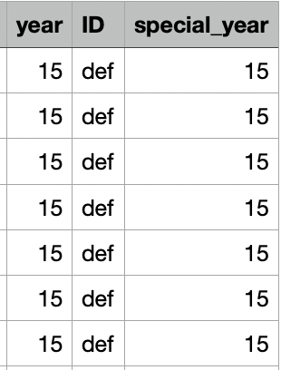
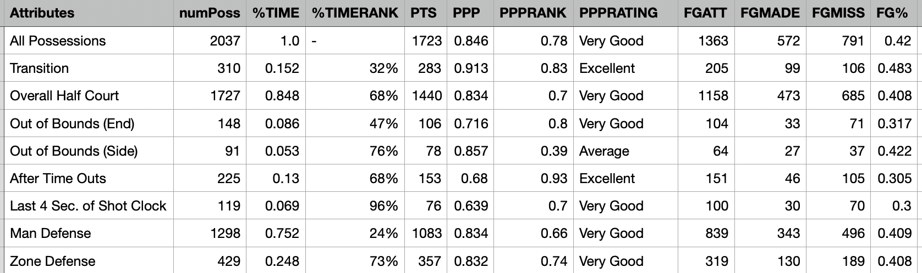
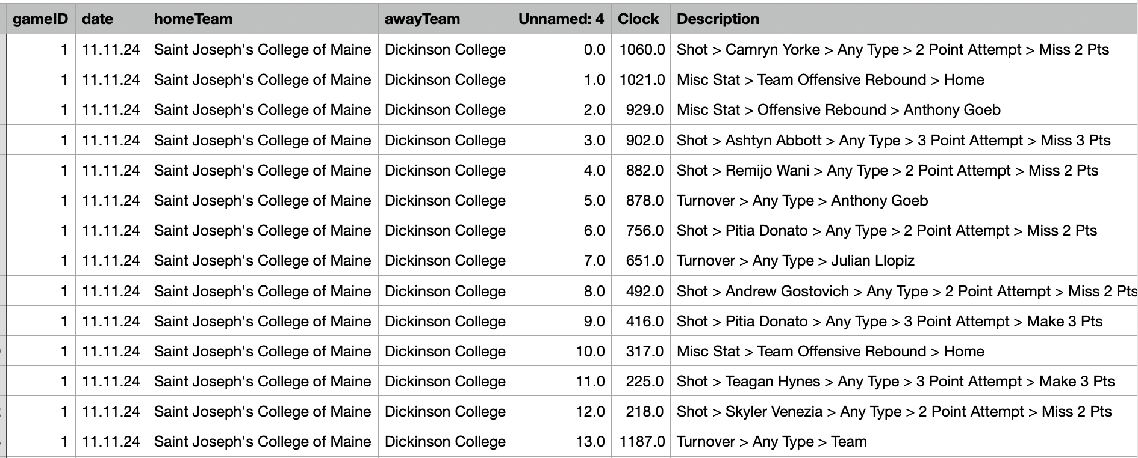
Snapshots of Datasets
Season data
Play-by-play

Slide 5
Data Retrieval
Season-level data:
Gathered by "printing" the page as a pdf and converting the pdf in Excel
Averages from the entire season at a player level and a team level
Averages of performance overall and after certain events
Divided into offensive and defensive statistics (ID column)
Contains a rating for every statistic
- poor, below average, average, good, very good, excellent
Play-by-play data:
Gathered by scraping from the Synergy Sports website --> API found when inspecting
Description of every play for each game from the 2023-24 season
Created dummy variables indicating what type of event occurred
Foul, shot, rebound, assist, turnover, block, steal

Slide 6
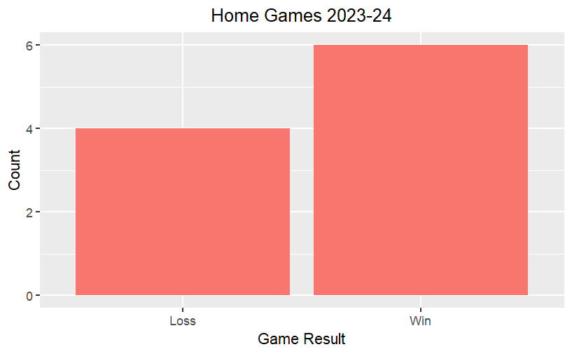
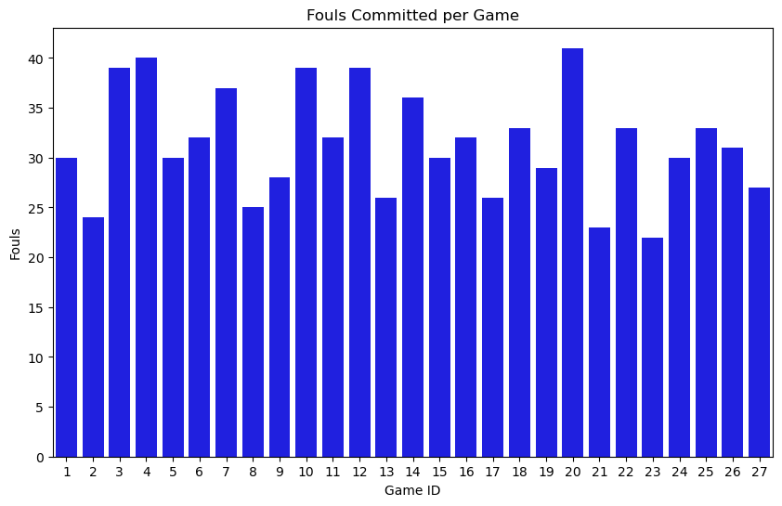
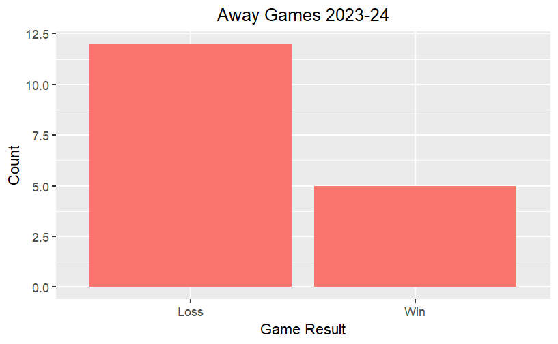
Exploratory Data Analysis (Play-by-play)

Slide 7

Season-Level Ratings Analysis

Slide 8
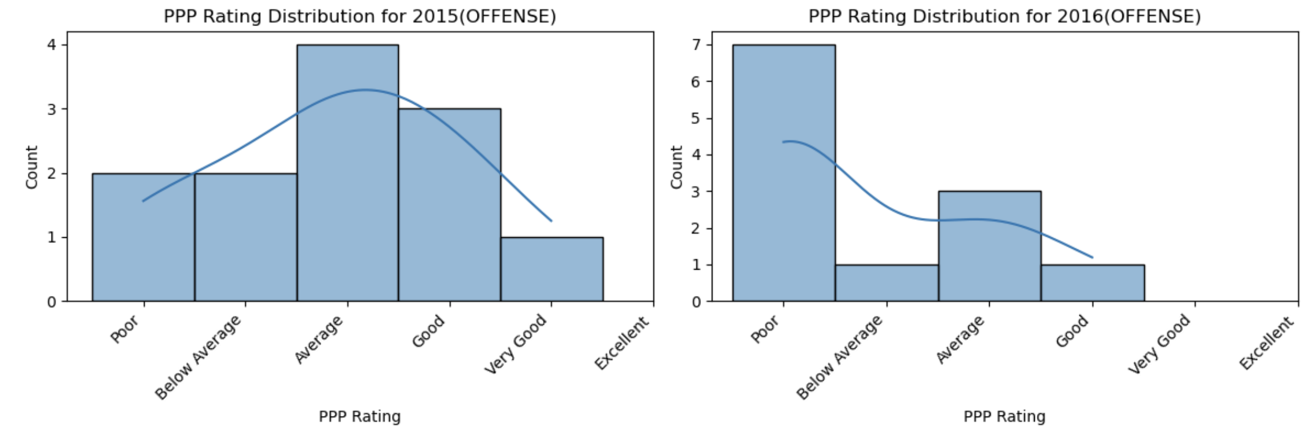
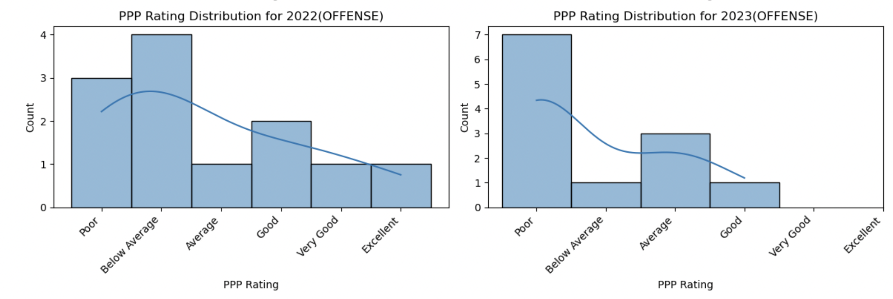
Offensive ratings for special years

Slide 9
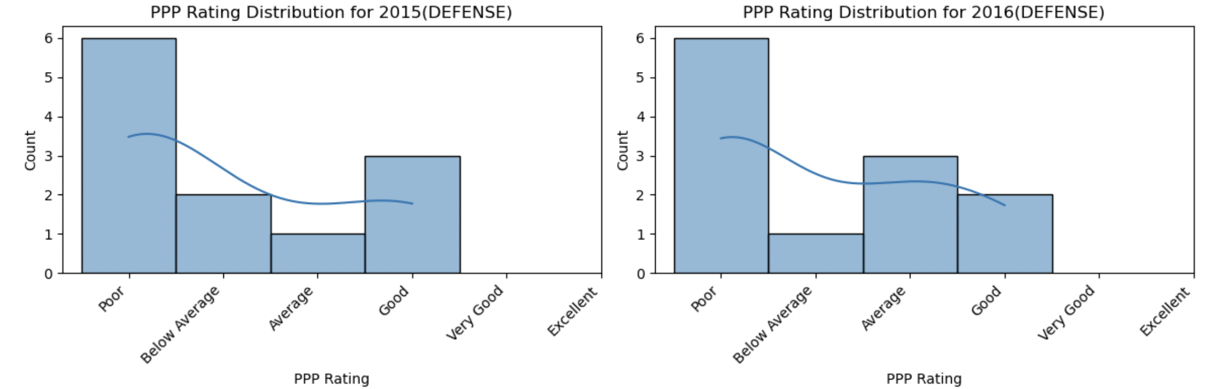
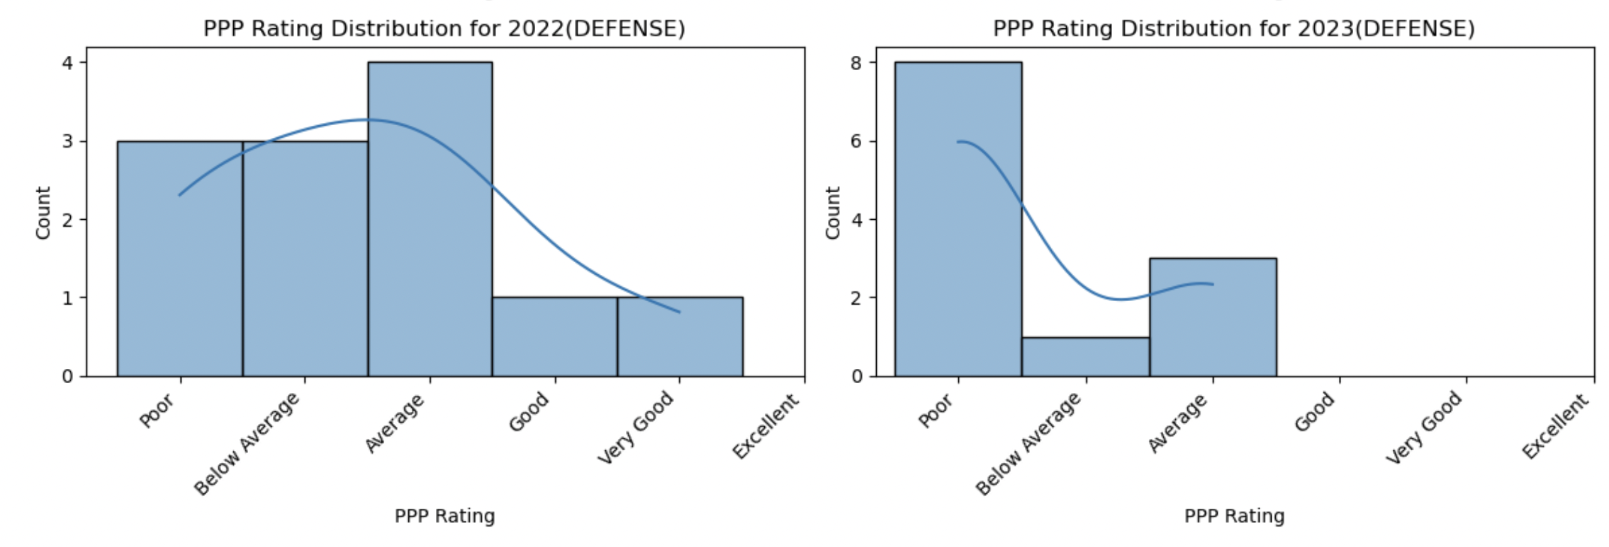
Defensive ratings for special years

Slide 10
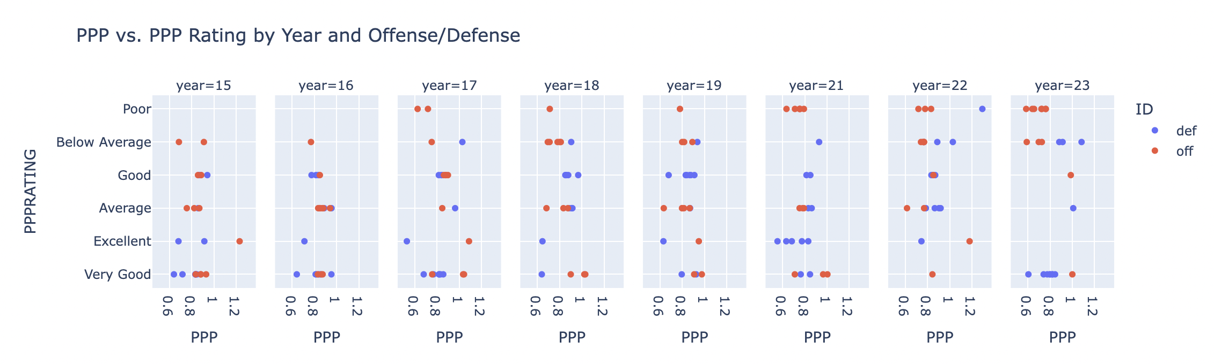
PPP Rating by Year and Offense/Defense
As time passes, there are more "poor" PPP Ratings for offensive categories and more "very good" ratings for defensive categories.

Slide 11
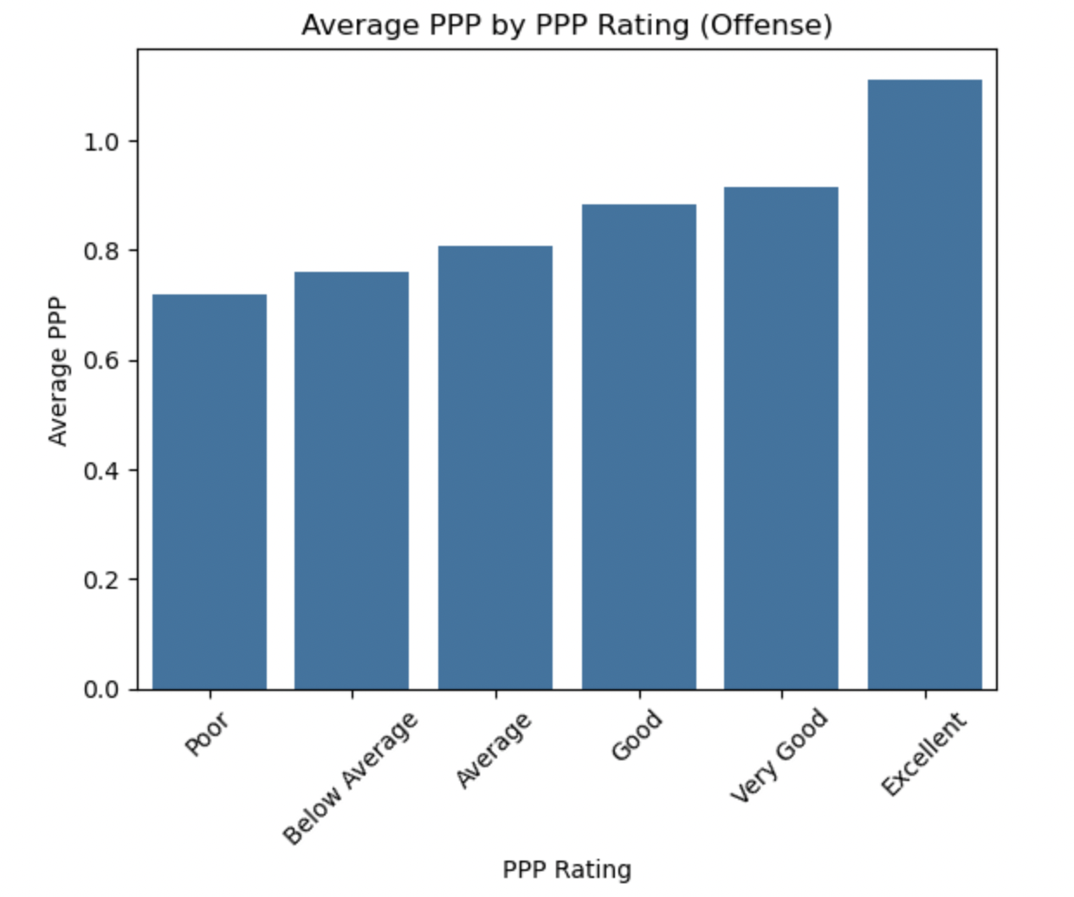
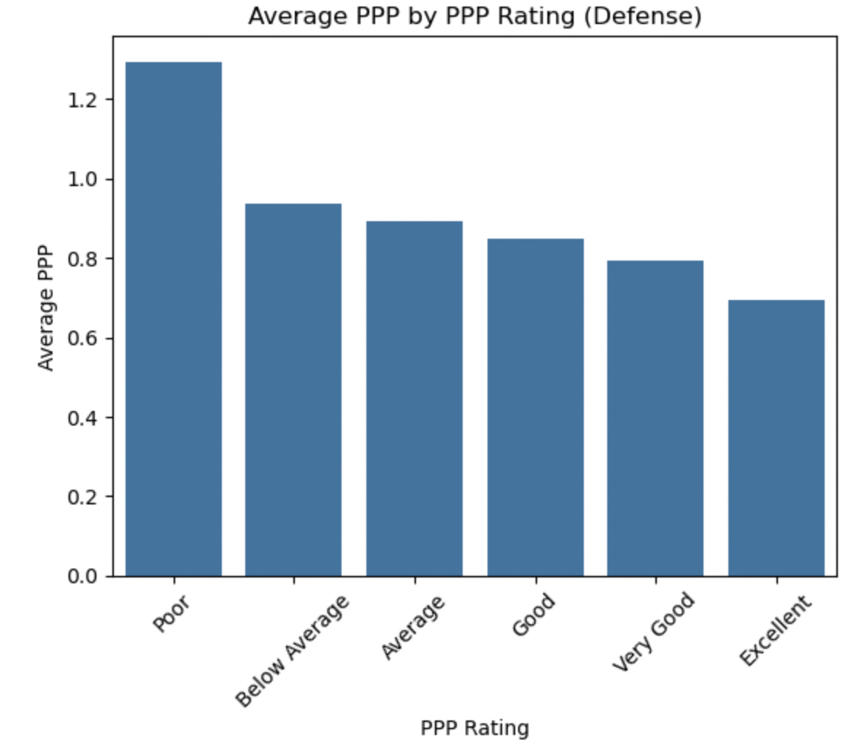
Average PPP by Rating

Slide 12
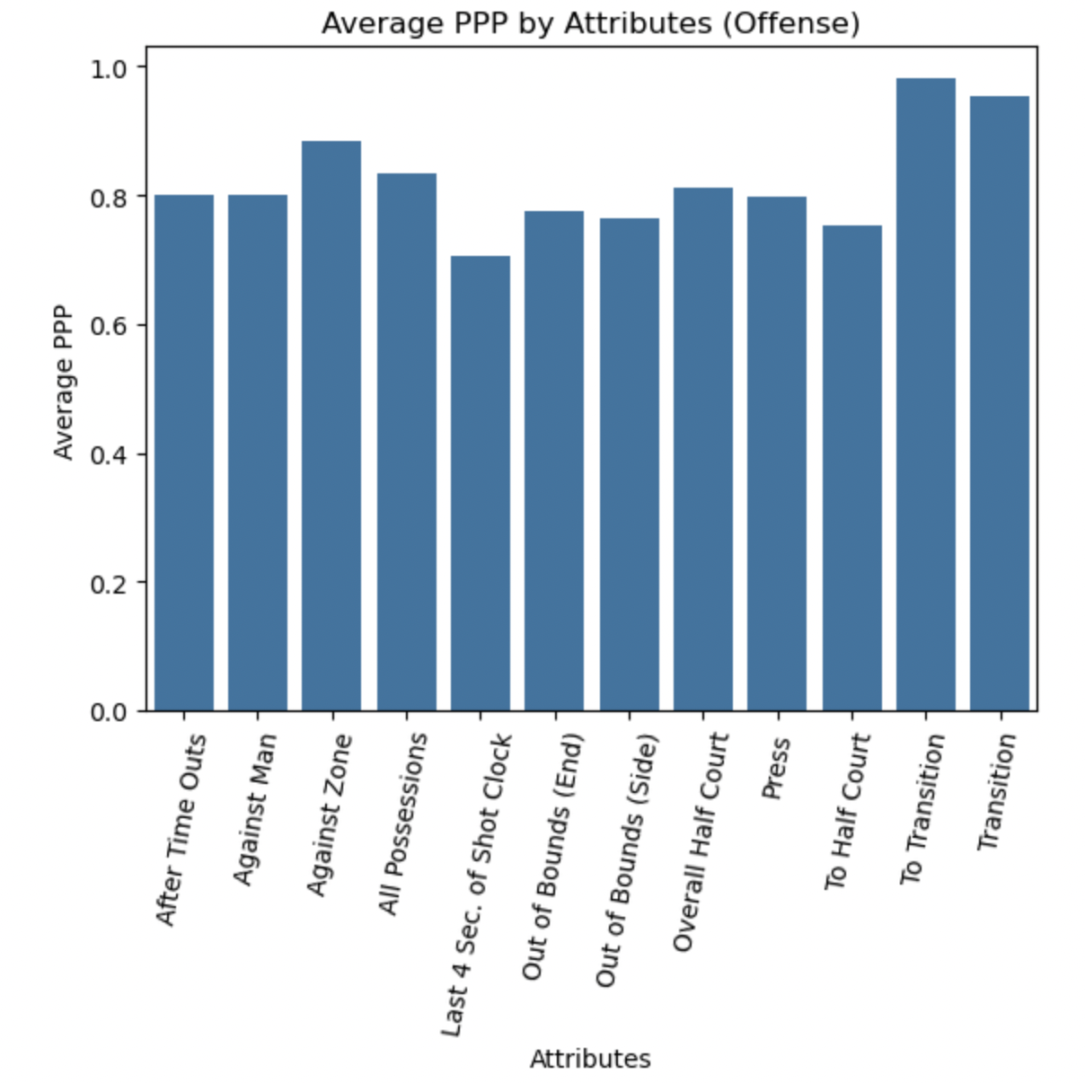
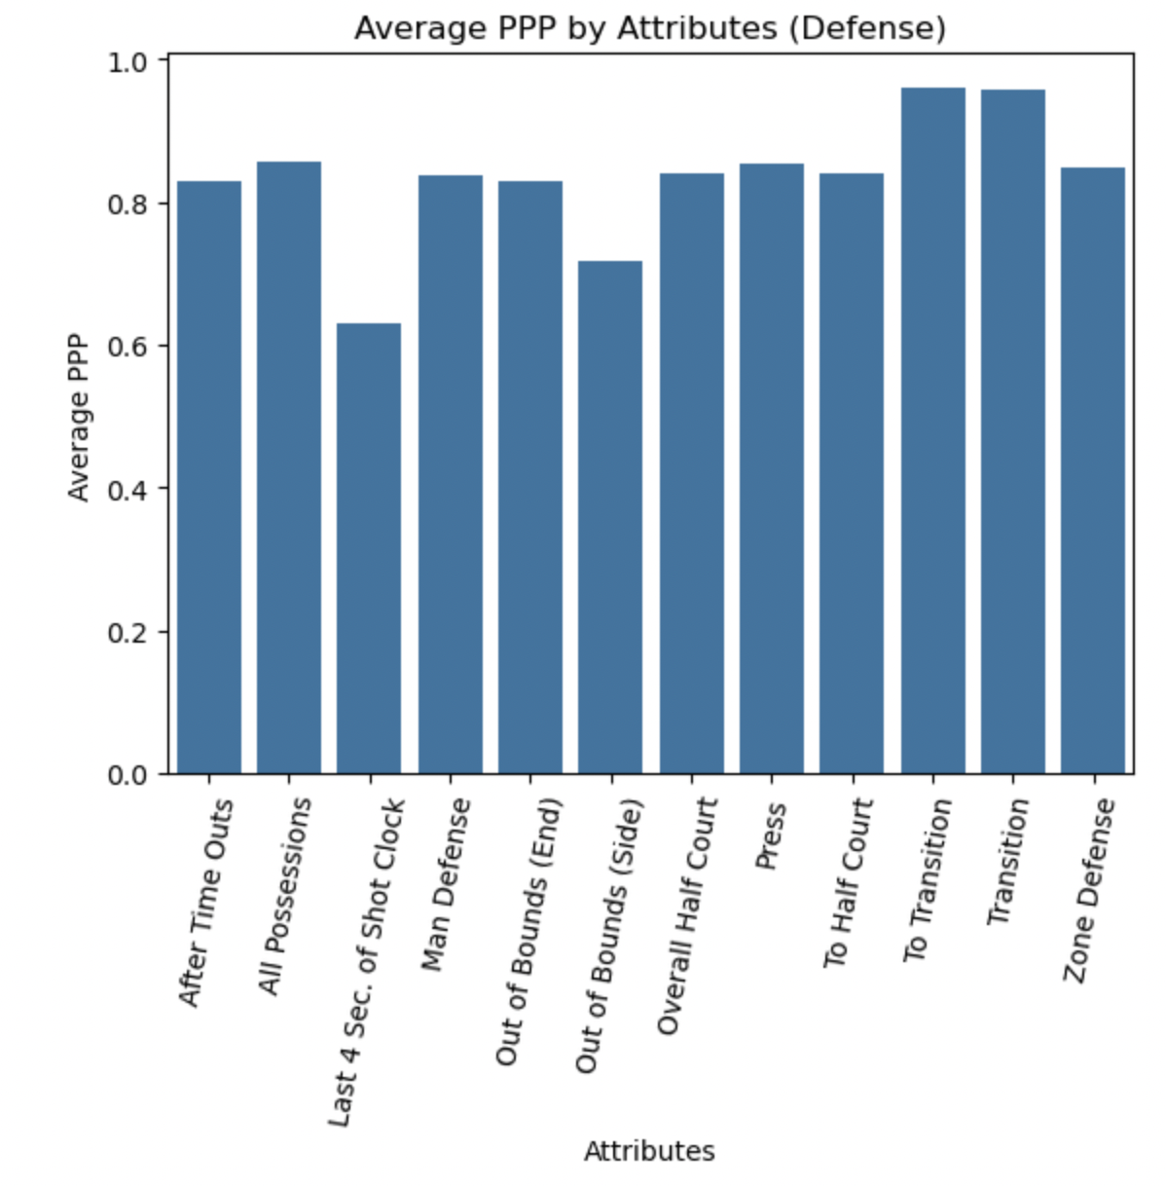
Average PPP by Attributes

Slide 13
Overall findings of preliminary analysis
Offensive categories have worse ratings as we get to more recent seasons.
Numerous factors could be associated with this, including player abilities, improving opponent defenses, conference improving.
They won conference the year before our analysis begins...both offensive and defensive categories have worsened since.
Lots of variance in fouls committed per game
Home team wins more often (as expected)

Slide 14
Model Specification
Season-level data:
We aim to analyze the significance of certain season metrics to predict their impact on the PPP value.
To do this, we conducted a variety of regression analyses: OLS regression with variety of control variables, separating regressions by offense and defense, and using interaction terms to determine the relationship between variables changing with one another.
Game-level data:
Our goal is to analyze the games of the 2023-24 season and estimate which factors are most impactful for a win.
Number of fouls and rebounds for Dickinson and opponent, home/away game

Slide 15
Model Specification
We aim to predict the PPP ratios for certain seasons while accounting for Attribute (Transition, Zone defense, last 4 sec on shot clock, etc.) and other offensive/defensive variables
Regression analysis using in-game statistics value to predict PPP ratios.
We want to find which factors most effect whether Dickinson will win a game so that the team will be able to focus on those factors more than others that don't have as strong as an effect

Slide 16
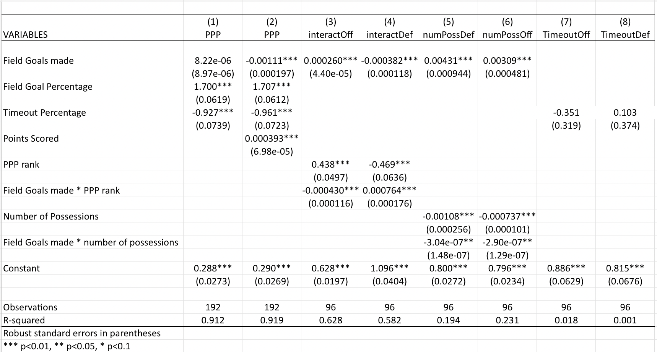
Model Results (Stata)
Interpretation/Analysis
Column 3 (Interactions for Offense):
If the FGMADE increases by one shot, the PPP is expected to increase as well. When PPP Rank increases, PPP is expected to increase, as expected.
However, when both increase (interaction term), the PPP is expected to decrease, which is concerning.
Column 4 (Interactions for Defense):
If FGMADE increases by one shot, PPP is expected to decrease, which makes sense for defensive purposes and opponent difficulty.
Column 6 (numPoss for Offense):
Interesting: Both coefficients on numPoss are negative, indicating that when the number of possessions increase, the PPP is expected to decrease.
This is a bad sign for offense because you would've hoped that as the number of possessions increase, then the points per possession (PPP) would increase as well.

Slide 17
Strengths of Model Estimates
When analyzing just offensive or defensive statistics separately, Column 3 (Interactions for Offense) has the highest R squared value with all coefficients being statistically significant at alpha = 0.01. The variables used to predict PPP are Field Goals made, PPP rank, and the interaction between those variables.
Timeout percentage seems to be insignificant in predicting the PPP value.
Shouldn't use timeout percentage as a driving analysis factor.

Slide 18
Model Results (R)
Created a logistic model to determine the impact of different variables on a binomial outcome
Binary outcome: Dickinson win
Variables: Dickinson/opponent rebounds, fouls, blocks, turnovers, home/away game
More likely to win a home game than away
Dickinson fouls hurt their chances more than opponent fouls help
Rebounds and turnovers have very similar impacts whether it was Dickinson or their opponent
Getting blocks is more impactful for Dickinson than their opponents blocking them

Slide 19
Overall Findings
Stata Model:
When analyzing a continuous variable as our variable of interest (PPP), scoring statistics are more directly correlated to influencing the PPP score compared to variables that are not linked to scoring points (timeouts).
Even though the coefficients on timeout percentage are insignificant, the signs are worth noting when assessing the direction that they influence PPP.
Offensive = negative; defensive = positive
R Model:
To win games, Dickinson must focus on getting less fouls and getting more blocks
The recruiting process could be impacted, as it has been seen that the program likes to recruit players whose height could play a significant factor in their roster creation.
Home games are won more often than away games

Slide 20
Implications for Stakeholders
These results can be used by Dickinson basketball players, coaches, opponents, or even prospective students who want to evaluate the team's past performance
Dickinson basketball can alter their practice and game plans according to certain Attributes that were found to be weak
The program could try to recruit players who balance out their weaker aspects in hopes to find better success
Athletic Directors care about wins, which data analysis can help with; wins help with fundraising and overall college reputation

Slide 21
Ethical, Legal, Societal Implications
Ethical/Legal: Note that Synergy Sports requires a subscription… we gained access through the Dickinson Men's basketball assistant coach.
Ideally we wouldn't share this with opponents but they could use the Synergy Sports platform to conduct their own analyses.
No intentions to sell results or use beyond the scope of Dickinson Athletics.
Societal: The Dickinson basketball program can get a better sense of their performance and trends from previous years. Prospective students can use the knowledge of previous success to make a decision on transferring or attending the school.

Slide 22

Thank you!!!!

